Slide 1


Terraform Tutorial for Beginner
2023

Slide 2


TERRAFORM TUTORIAL FOR BEGINNER MASTERMIND ACADEMY
TERRAFORM

Slide 3
TERRAFORM TUTORIAL FOR BEGINNER MASTERMIND ACADEMY
TABLE OF CONTENT
What is Terraform?
What is Infrastructure as Code?
How Terraform Works
Workflows
Terraform Elements
Advantages of Terraform
Terraform & Ansible

Slide 4
TERRAFORM TUTORIAL FOR BEGINNER MASTERMIND ACADEMY
What is Terraform?

Slide 5

TERRAFORM TUTORIAL FOR BEGINNER MASTERMIND ACADEMY
Terraform is the infrastructure as code offering from HashiCorp.
It is a tool for building, changing, and
managing infrastructure in a safe,
repeatable way.

Slide 6
TERRAFORM TUTORIAL FOR BEGINNER MASTERMIND ACADEMY
What is Infrastructure as Code (IaC)?

Slide 7
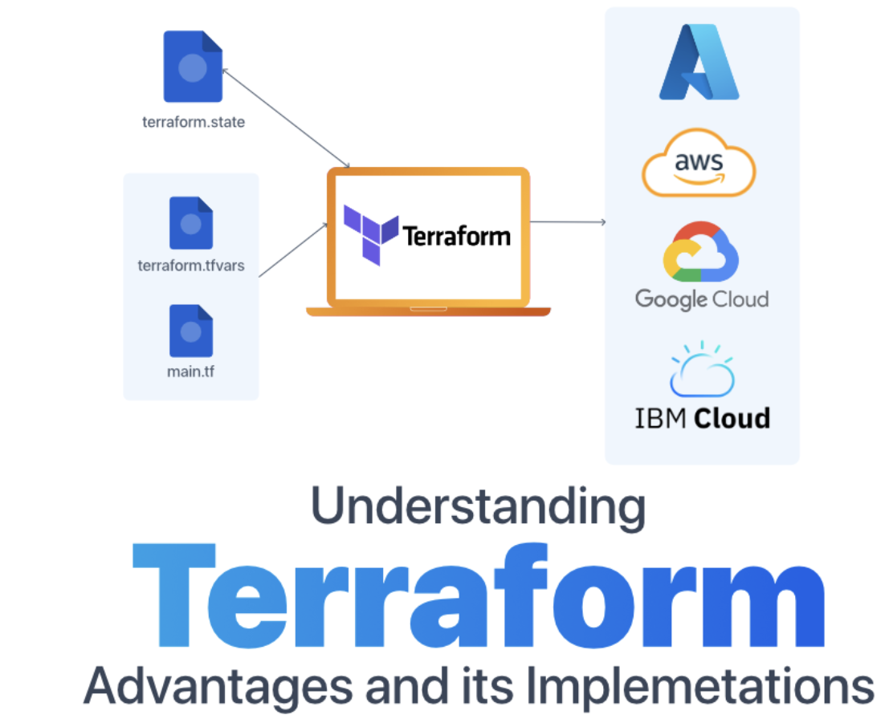
TERRAFORM TUTORIAL FOR BEGINNER MASTERMIND ACADEMY
IaC is the process of managing
infrastructure in a file or files rather than manually configuring resources in a user interface.

Slide 8
TERRAFORM TUTORIAL FOR BEGINNER MASTERMIND ACADEMY
How Terraform Works?

Slide 9
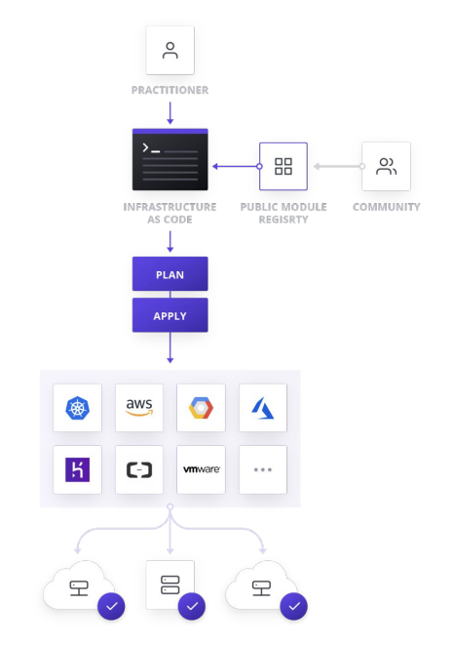
TERRAFORM TUTORIAL FOR BEGINNER MASTERMIND ACADEMY
Terraform allows infrastructure to be expressed as code in a simple, human readable language called HCL
(HashiCorp Configuration Language).
Terraform reads configuration files and
provides an execution plan of changes,
which can be reviewed for safety and
then applied and provisioned.

Slide 10
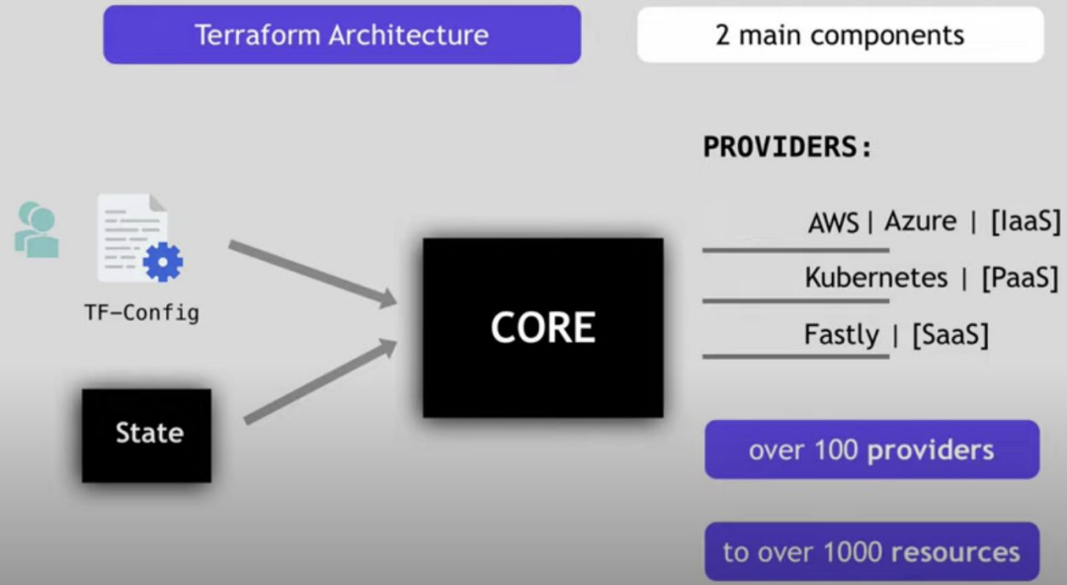
TERRAFORM TUTORIAL FOR BEGINNER MASTERMIND ACADEMY
How Terraform Works?

Slide 11
TERRAFORM TUTORIAL FOR BEGINNER MASTERMIND ACADEMY
Workflows ( İş Akışı )

Slide 12
TERRAFORM TUTORIAL FOR BEGINNER MASTERMIND ACADEMY
A SIMPLE WORKFLOW for deployment will follow closely to the steps below.
SCOPE: Confirm what resources need to be created for a given project
AUTHOR: Create the configuration file in HCL based on the scoped parameters
INITIALIZE: Run terraform init in the project directory with the configuration files. This will download the correct provider plug-ins for the project.
PLAN & APPLY: Run terraform plan to verify creation process and then terraform apply to create real resources as well as state file that compares future changes in your configuration files to what actually exists in your deployment environment.

Slide 13
TERRAFORM TUTORIAL FOR BEGINNER MASTERMIND ACADEMY
Terraform Elements

Slide 14
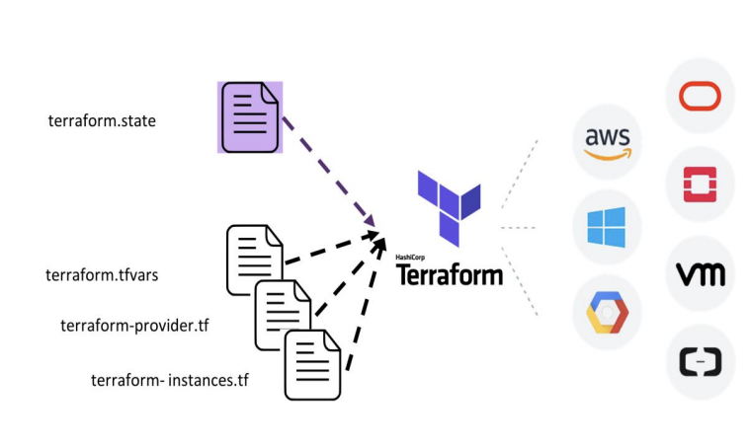
TERRAFORM TUTORIAL FOR BEGINNER MASTERMIND ACADEMY
State
This state is used by Terraform to map real world resources to your configuration, keep track of metadata, and to improve performance for large infrastructures. Terraform uses this local state to create plans and make changes to your infrastructure. State is a necessary requirement for Terraform to function.

Slide 15

TERRAFORM TUTORIAL FOR BEGINNER MASTERMIND ACADEMY
Providers
A provider is responsible for
understanding API
interactions and exposing
resources. Every Terraform
provider has its own
documentation, describing its
resource types and their
arguments.

Slide 16
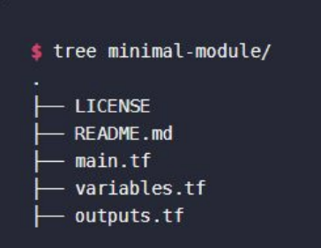
TERRAFORM TUTORIAL FOR BEGINNER MASTERMIND ACADEMY
Modules
A Terraform module is a set of Terraform
configuration files in a single directory. Even a simple configuration consisting of a single
directory with one or more «.tf» files is a
module. When you run Terraform commands
directly from such a directory, it is considered
the root module. So in this sense, every
Terraform configuration is part of a module.

Slide 17

TERRAFORM TUTORIAL FOR BEGINNER MASTERMIND ACADEMY
Modules
A "backend" in Terraform determines how state is loaded and how an operation such as <apply> is executed. By default, Terraform uses the "local" backend, which is the normal behavior of Terraform you're used to. Backends are completely optional. You can successfully use Terraform without ever having to learn or use backends. Backends are used for keeping sensitive information off disk.

Slide 18
TERRAFORM TUTORIAL FOR BEGINNER MASTERMIND ACADEMY
Advantages of Terraform

Slide 19
TERRAFORM TUTORIAL FOR BEGINNER MASTERMIND ACADEMY
Advantages of Terraform
Platform Agnostic
In a modern datacenter, you may have several different clouds and
platforms to support your various applications.
With Terraform, you can manage a heterogeneous environment
with the same workflow by creating a configuration file to fit the needs
of your project or organization.

Slide 20
TERRAFORM TUTORIAL FOR BEGINNER MASTERMIND ACADEMY
Advantages of Terraform
State Management
Terraform creates a state file when a project is first initialized. Terraform uses this local state to create plans and make changes to your infrastructure.
Prior to any operation, Terraform does a refresh to update the state with the real infrastructure. This means that Terraform state is the source of truth by which configuration changes are measured.
If a change is made or a resource is appended to a configuration, Terraform compares those changes with the state file to determine what changes result in a new resource or resource modifications.

Slide 21
TERRAFORM TUTORIAL FOR BEGINNER MASTERMIND ACADEMY
Advantages of Terraform
Operator Confidence
The workflow built into Terraform aims to instill confidence in users by promoting easily repeatable operations and a planning phase to allow users to ensure the actions taken by Terraform will not cause disruption in their environment.
Upon terraform apply, the user will be prompted to review the proposed changes and must affirm the changes or else Terraform will not apply the proposed plan.

Slide 22
TERRAFORM TUTORIAL FOR BEGINNER MASTERMIND ACADEMY
Terraform & Ansible

Slide 23
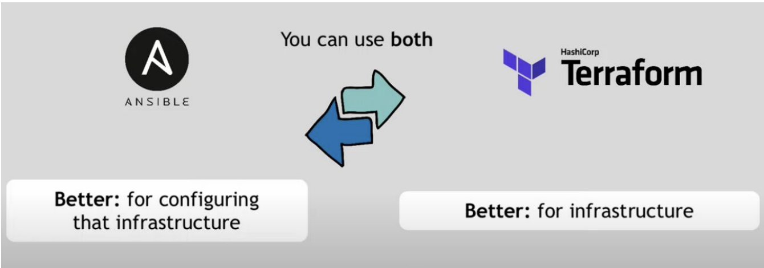
TERRAFORM TUTORIAL FOR BEGINNER MASTERMIND ACADEMY
Terraform & Ansible

Slide 24
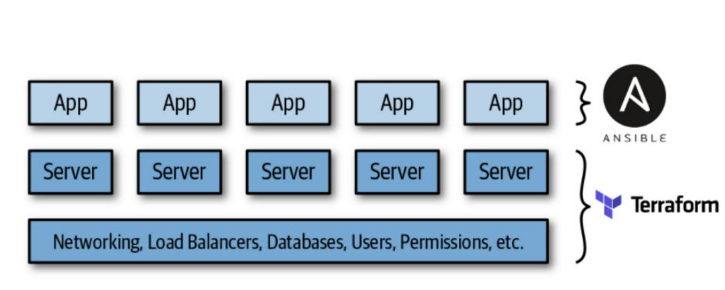
TERRAFORM TUTORIAL FOR BEGINNER MASTERMIND ACADEMY
Terraform & Ansible

Slide 25
TERRAFORM TUTORIAL FOR BEGINNER MASTERMIND ACADEMY
Terraform & Ansible
. Terraform Documentation
• Hashicorp/terraform (Github Page)
• Shuaibiyy/awesome-terraform
• tfutils/tfenv
• gruntwork-io/terragrunt
• 28mm/blast-Radius
• Terraform Registry

Slide 26


